Slide 1
Time-domain processing
COMP.SGN.120
Introduction to Audio processing
Lecture 6

Slide 2
Introduction
Time-domain algorithms:
Amplitude/phase modulators
Filters
Delay lines modulators
Influence the pitch and/or time duration of the signal.
Follow the analysis and synthesis stages.

Slide 3
Measures and Quantities
RMS
Power
Intensity

Slide 4
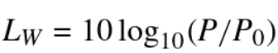
Power
It is defined in watts [W]
Sound power is the property of a sound source radiating energy along with the sound wave it creates.
Sound power level in decibels is defined as:
P is sound power [W]
$P_{0 }$is the reference power of $1∙{10}^{−12}W$, the lowest sound we can discern.

Slide 5
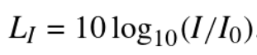
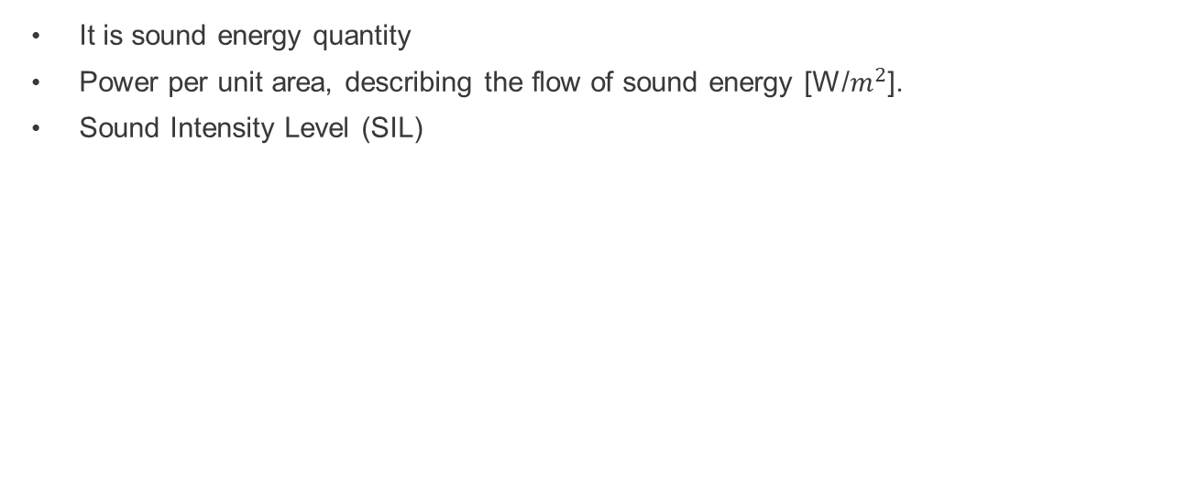
Intensity
It is sound energy quantity
Power per unit area, describing the flow of sound energy [W/$m^{2}$].
Sound Intensity Level (SIL)
$I_{0 }$is the reference of $1∙{10}^{−12}W[W/m^{2}]$

Slide 6
Pressure
Sound source produces sound power which generates a sound pressure fluctuation in the air.
Sound Pressure Level (SPL) quantify (in decibels) the strength od a sound source.
Vary with distance from the source and are affected by the obstacles, barriers, air absorption, wind, etc.

Slide 7
Sound reproduction

Slide 8
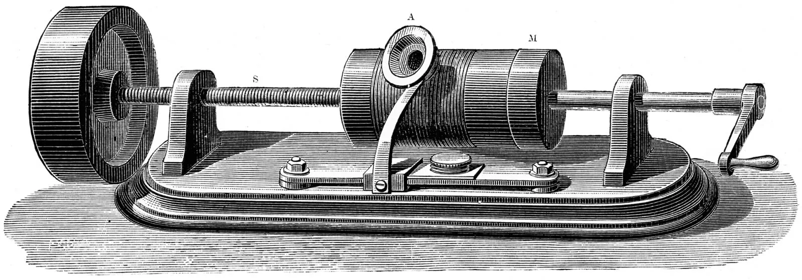
Sound reproduction
Recording, processing, storing and recreating sound (speech, music, environmental, etc).
First phonograph built by Thomas Edison, 1877.
Audio engineering refers to the production of audio content, signals that have meaning or value to a listener. E.g. the music recorded in the studio.
Some tools to modify audio signals (audio effects) used in audio engineering are:
Equalization
Dynamic range control
Panning
Reverberation

Slide 9
Audio effects
Dynamic range control

Slide 10
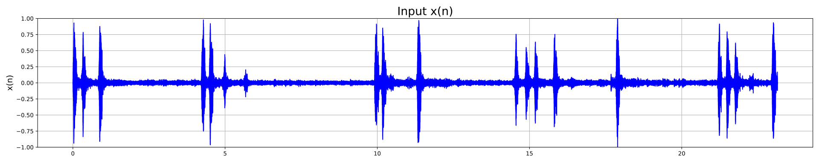
What is dynamic range control?
Sound pressure level of natural sounds varies over time
Movies, music: The loudness of sounds works as an effect and is part of the content
When recording, the distance to microphone may vary, which causes unwanted level variation
Dynamic range of audio signals:
Ratio of maximum to minimum signal levels over a period of time
Expressed in decibels, audio typically 40 dB – 120 dB
Dynamic range control
Combination of level measurement and adaptive level adjustment

Slide 11
What is DRC useful for?
When recording, it is desirable to:
Use the full amplitude range optimally
Also to protect AD converters from overloading (clipping)
When playing back music or speech e.g. in a car, dynamic range variation has to be matched to background noise
Noise would not mask the quiet parts of the signal
Listening becomes easier / possible
Live music contains a dynamic range too wide for reproduction in the average home
Suppress low-amplitude noise using noise gates
Only audio signals exceeding a certain level is passed through
In various recording formats, the limited range of amplitudes should be optimally used

Slide 12
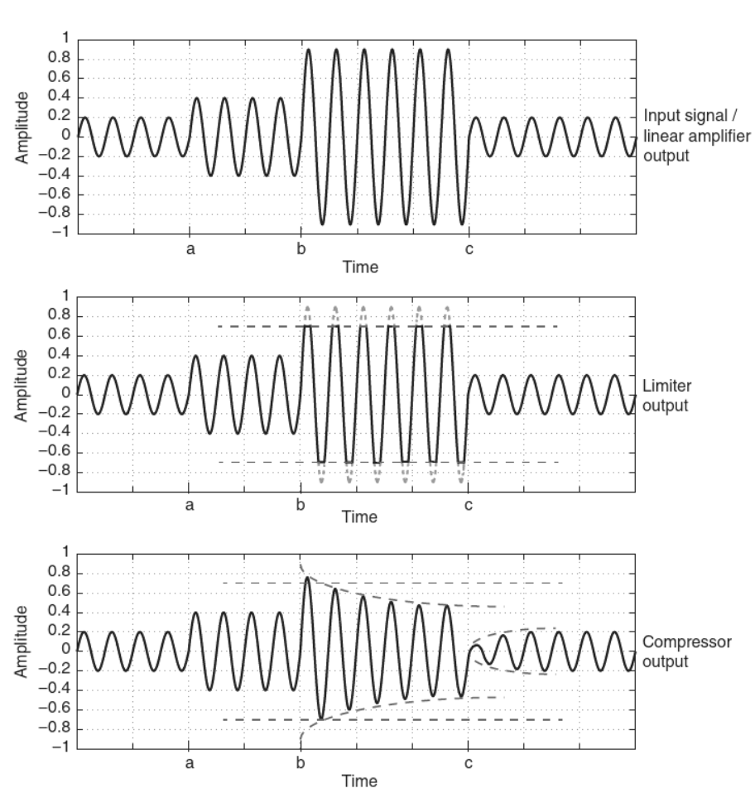
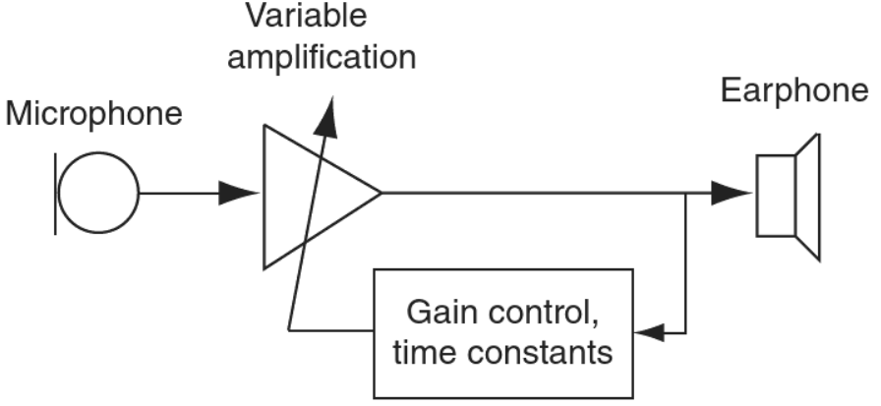
Dynamic processing or automatic gain control
Compressor: attenuates sound the more the level increases beyond certain threshold.
Limiter: limits the level of a signal to a preset value.
Expander: leaves large amplitudes untouched, increasingly amplifies the signal the smaller the amplitude is.
E.g., applications: hearing aids.

Slide 13
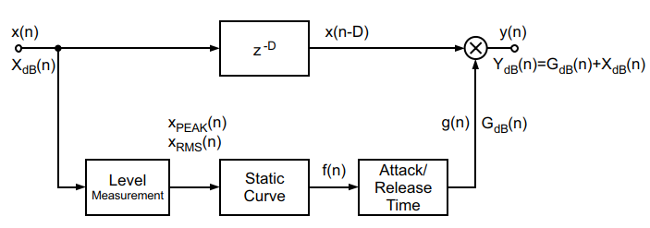
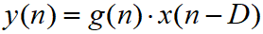
DRC block diagram
Measure the level of input signal
Multiply the delayed input signal by factor g(n)
Delaying signal x(n) compared to the control signal g(n) allows ”predictive” level control (gain goes down before any ”big bangs”)
Value of gain factor g(n) is calculated in two steps
Static curve defines desired output level corresponding to the input level
Temporal variation of g(n) is smoothed using a lowpass filter
Notes:
From book: Digital Audio Signal Processing by Udo Zölzer. 2008. Chapter 7

Slide 14
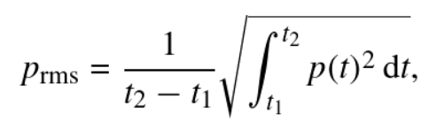
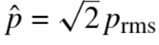
Root mean square vs PEAK
RMS or effective value.
Time range can be over one period (for a periodic signal) or a long enough (ideally infinite) time span (for non-periodic signal)
p(t) is pressure, force applied per unit area in a direction perpendicular to the surface of an object.
PEAK value, maximum value that the signal reaches in one cycle.
For a sinusoidal signal

Slide 15
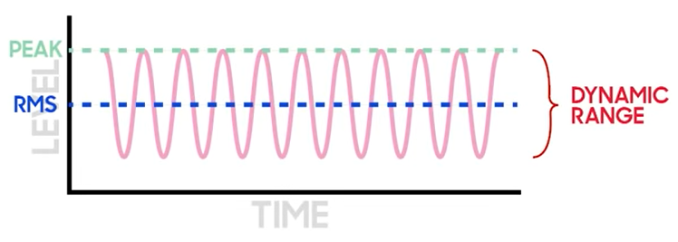
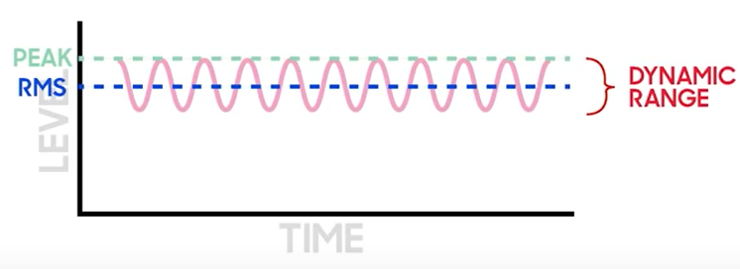
RMS, PEAK and dynamic range
More dynamic
Less compress
Smaller dynamic range
More compress

Slide 16
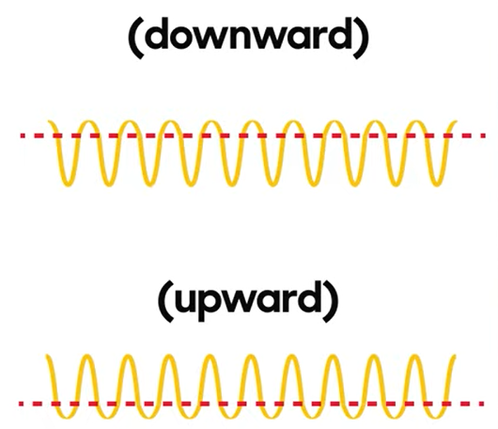
Dynamic range compression
Reduces the volume of loud sounds or amplifies quiet sounds
→ reducing/compressing dynamic range
→ Both downward and upward compression reduce the dynamic range of an audio signal.
Downward compression – reduces loud sounds over a certain threshold; quiet sounds remain unaffected.
Upward compression – increases the loudness of sounds below a certain threshold; leaves louder sounds unaffected.

Slide 17
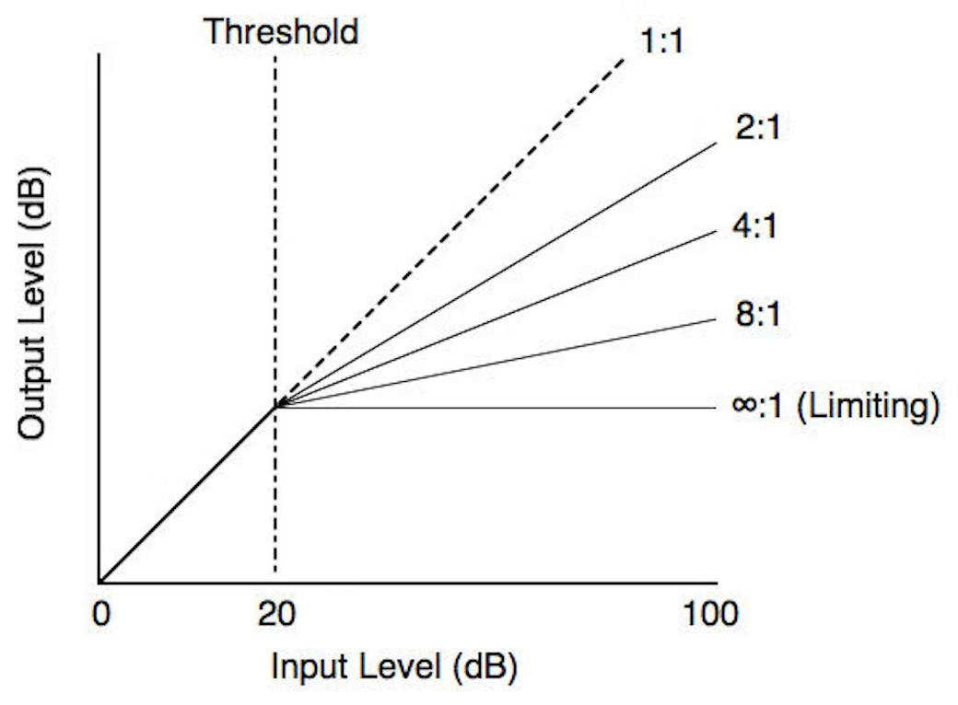
Dynamic range limited
Limiters limits the dynamic range, as a ceiling which the signal cannot pass.
If the compressor’s ration increases up to infinite (to a ceiling) then it becomes a limiter.
Avoids clipping

Slide 18
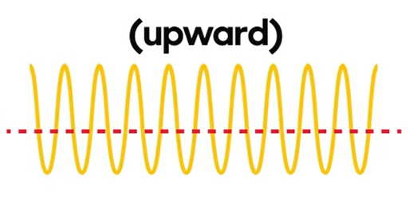
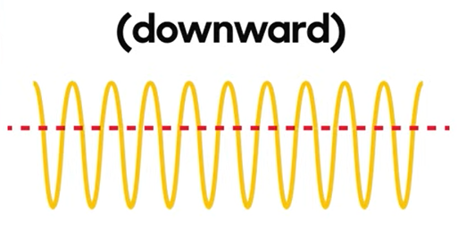
Dynamic range expansion
Upward expansion – amplify the level of a signal that passes the threshold.
Downward expansion – also known as gating, attenuates signal that drops below the threshold.

Slide 19
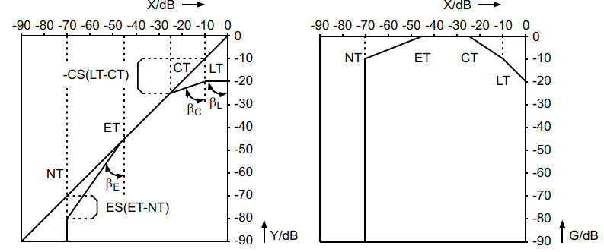
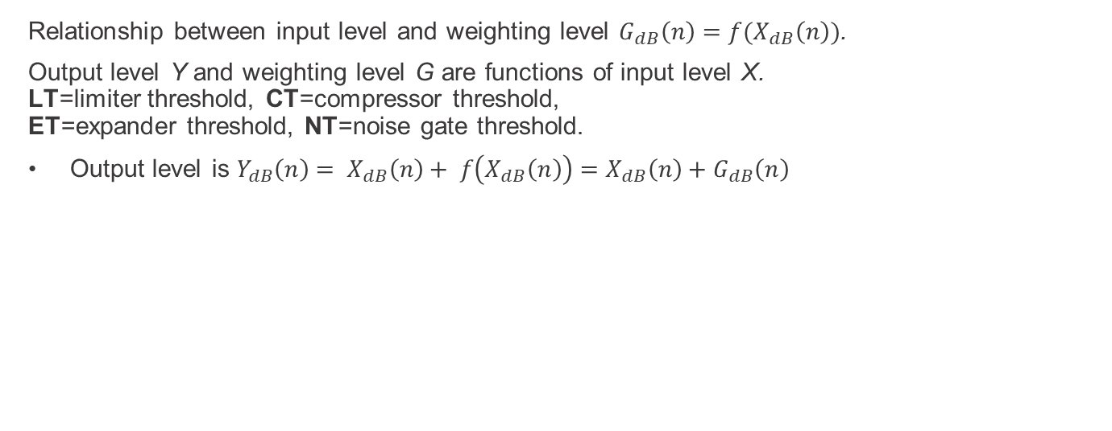
Static curve
Relationship between input level and weighting level $G_{dB}\left(n\right)=f(X_{dB}\left(n\right))$.
Output level Y and weighting level G are functions of input level X.
LT=limiter threshold, CT=compressor threshold,
ET=expander threshold, NT=noise gate threshold.
Output level is $Y_{dB}\left(n\right)= X_{dB}\left(n\right)+ f\left(X_{dB}\left(n\right)\right)=X_{dB}\left(n\right)+G_{dB}\left(n\right)$

Slide 20
Operation regions on the static curve
Limiter limits the output level when the input level exceeds the limiter threshold LT
All input levels above the threshold lead to a constant output level
Compressor maps a change of input level to a smaller change in the output level
Expander increases changes in the input level to larger changes in the output level
Noise gate is used to suppress low-level signals and to reduce noise
Threshold values in different parts of the static curve determine the lower limit for limiter and compressor and upper limit for expander and noise gate

Slide 21
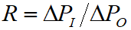
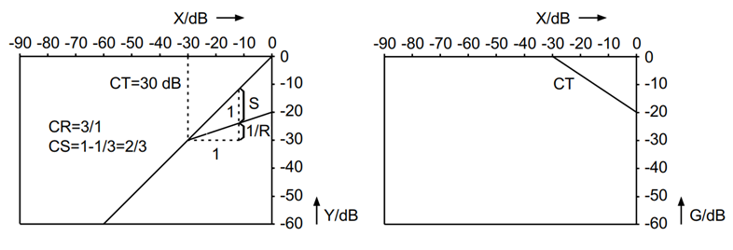
Compression ratio
Compression ratio is visible in the logarithmic representation of the static curve: ratio of input level change ΔP_{I} to output level change ΔP_{O}
Typical compression ratios:
R = (limiter), R > 1 (compressor), 0 < R < 1 (expander), R = 0 (noise gate at threshold)

Slide 22
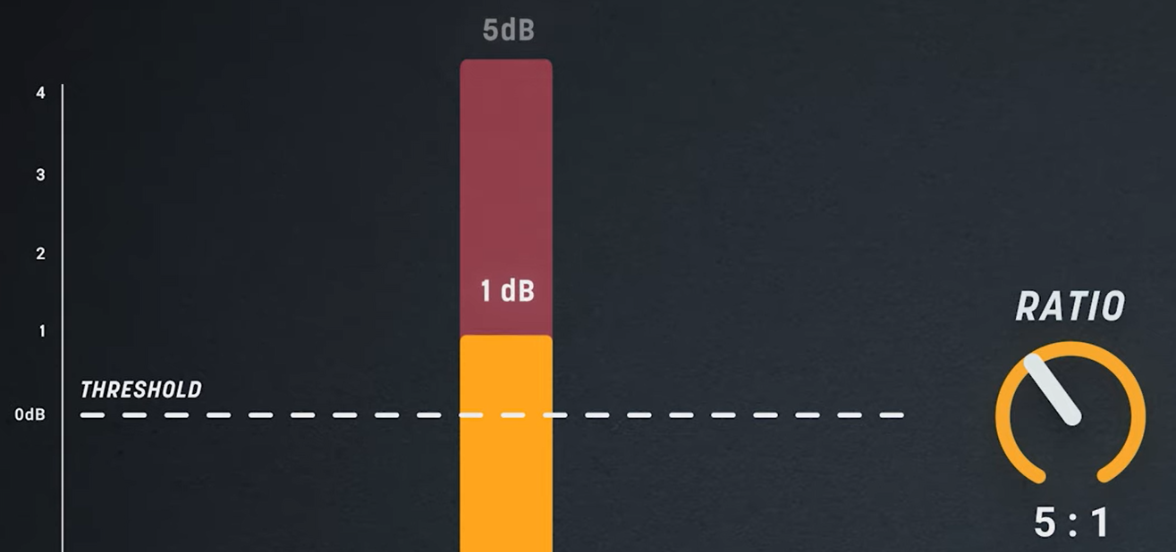
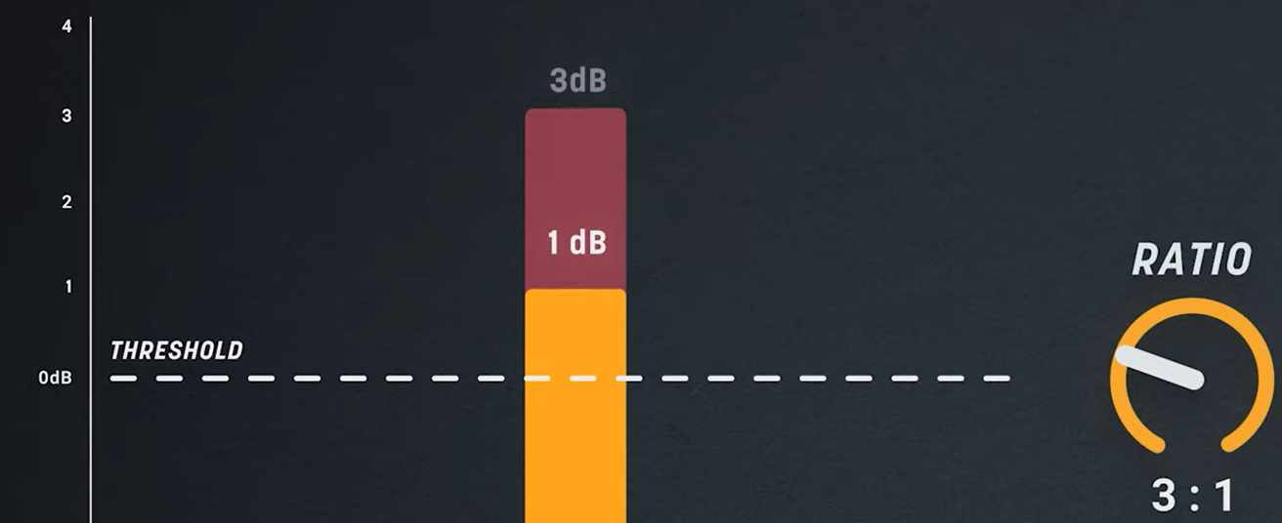
Compression ratio
How much compression occurs when the signal is above the threshold
For each 5 dB will output 1 dB
For each 3 dB will output 1 dB

Slide 23
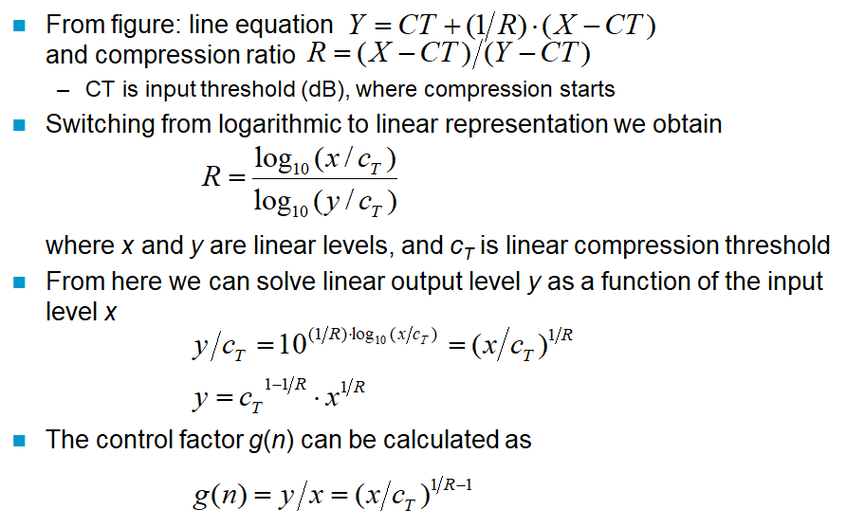
Compression ratio
For those who want more details,
not important for exam

Slide 24
Dynamic behavior
Besides static curve based level control, the dynamic (time-varying) behaviour of the control factor (attack and release time) plays a significant role in sound quality.
The rapidity of input signal level measurement also affects the rapidity of the overall dynamic range control.
There are two widely-used methods for level measurement: PEAK and RMS
Functionally interchangeable (same task)
However PEAK is typically used in the limiter, whereas RMS is used in compressor, expander and noise gate

Slide 25
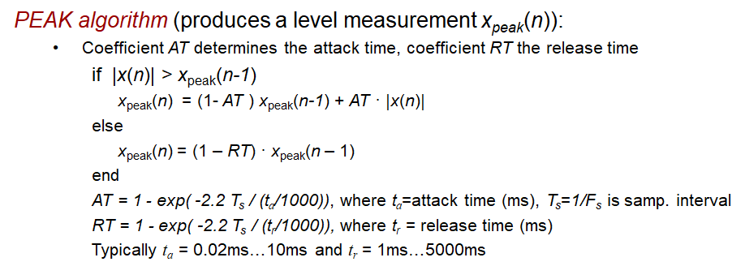
PEAK algorithm
For those who want more details,
not important for exam

Slide 26
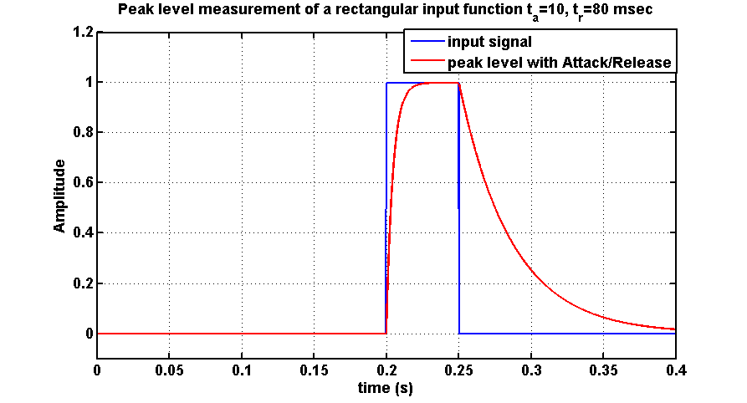
Peak measurement example
For a rectangular pulse

Slide 27
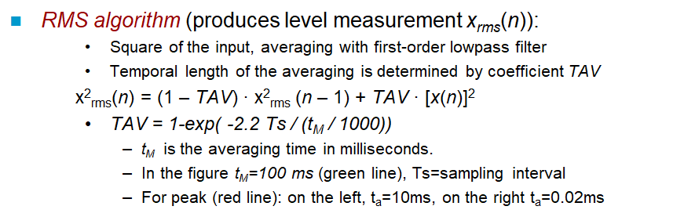
RMS algorithm
For those who want more details,
not important for exam

Slide 28
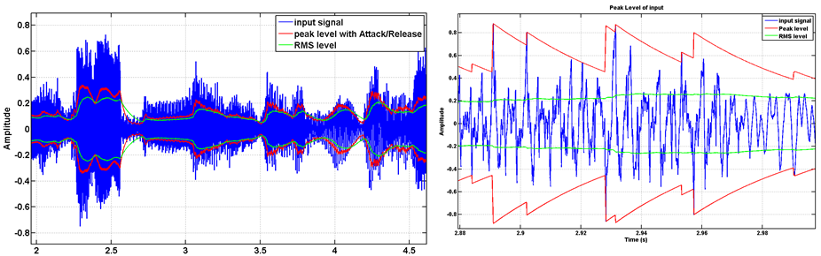
Peak and RMS measurement examples

Slide 29
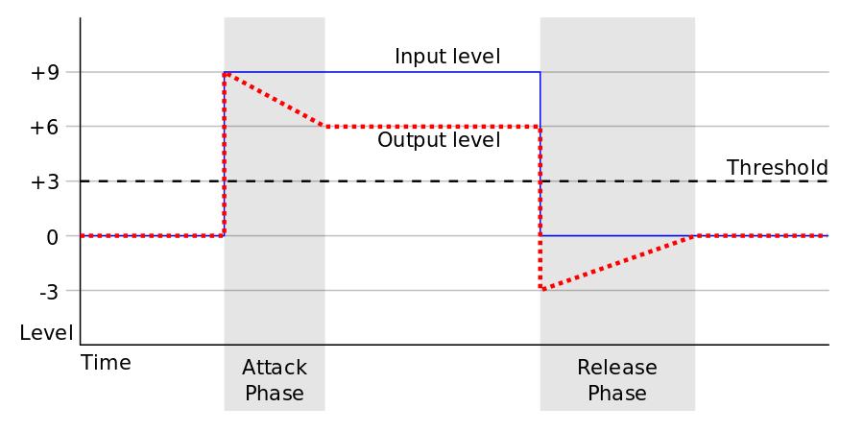
Attack and release
How quickly a device reacts to changes in input signal level.
Attack: period when the compressor is decreasing gain in response to increased level at the input
Release: period when the compressor is increasing gain in response to reduced level at the input.
These times are given by a filter, some are fixed by the circuit design and cannot be changed.

Slide 30
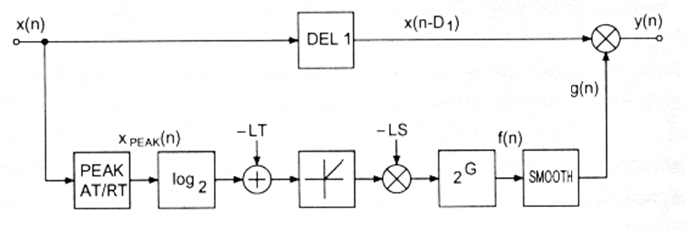
Example of a Limiter
Level x_{peak}(n) of input signal x(n) is measured using the PEAK algorithm
Value log₂[x_{peak}(n)] is compared to limiter threshold LT
If the value is above the threshold (difference is positive)
Difference is multiplied by the negative slope –LS of the limiter
Take antilogarithm 2^{G}
The resulting control factor f(n) is smoothed using first-order lowpass filter SMOOTH
If the value is not above the threshold, factor f(n) is set to value 1.
Delayed input signal x(n – D₁) is multiplied with the smoothed control factor g(n) to give the output y(n)

Slide 31
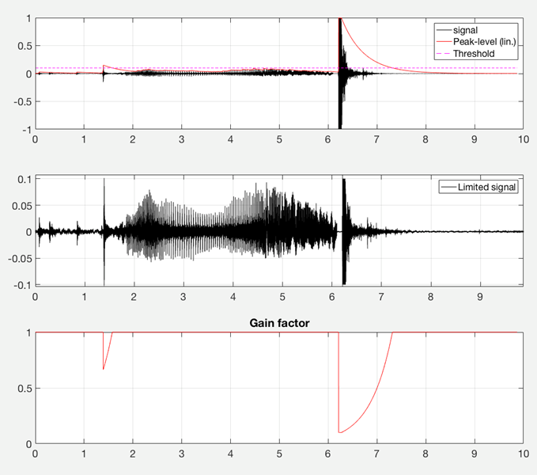

Door and gunshot sounds

Slide 32
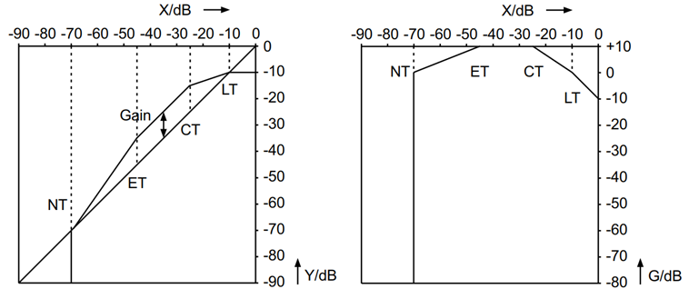
Combination system
The basic structure of compressor, expander, and noise gate is similar to the limiter
Practical implementation is a cascade, where each part implements one of the basic operations (limiter / compressor / expander)
Appropriate parameters can be chosen for each stage
Limiter using PEAK measurement, compressor/expander/noise gate using RMS
If LT threshold is crossed, use limiter to calculate characteristic curve
If LT is not crossed, log of RMS is used with one of three possible paths, depending on thresholds
By limiting the maximum level, the dynamic range is reduced → the overall static curve can be shifted up by a gain factor

Slide 33
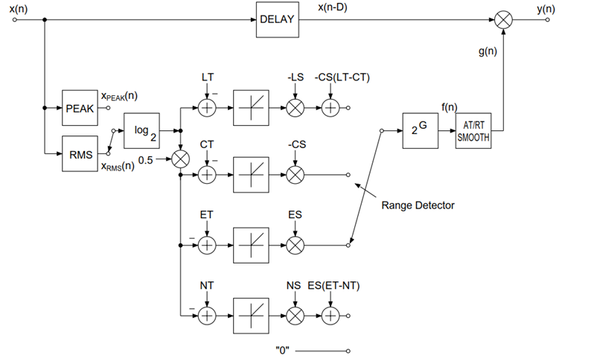
Combination system
You don’t have to know this diagram!

Slide 34
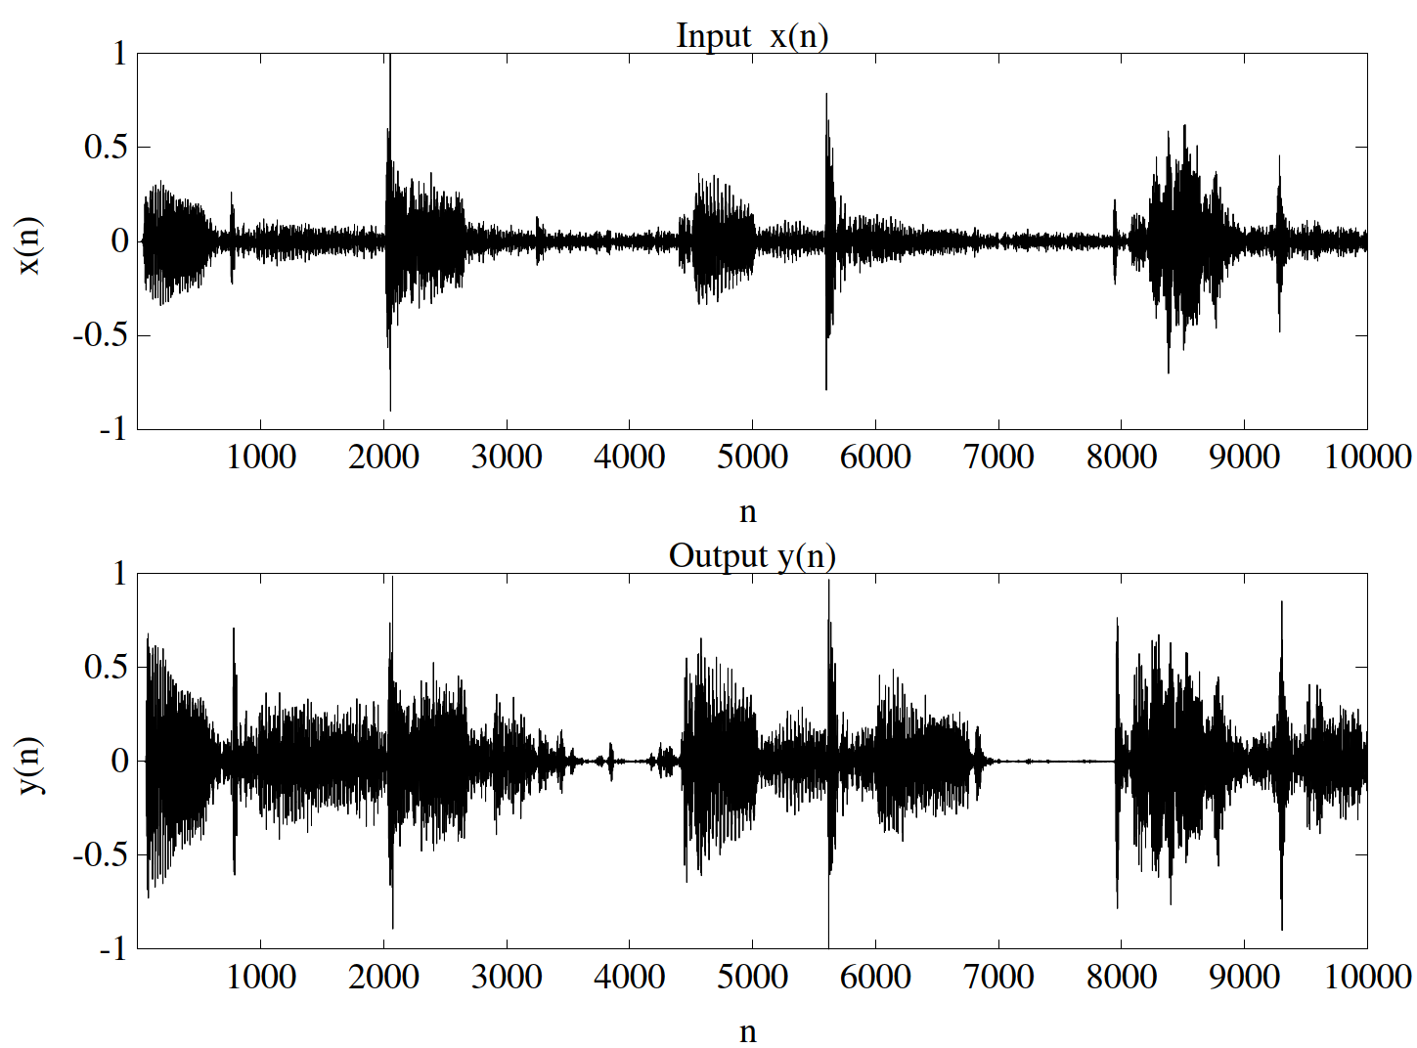
Combination system
Signals with high amplitude are compressed, ones with low amplitude are expanded

Slide 35
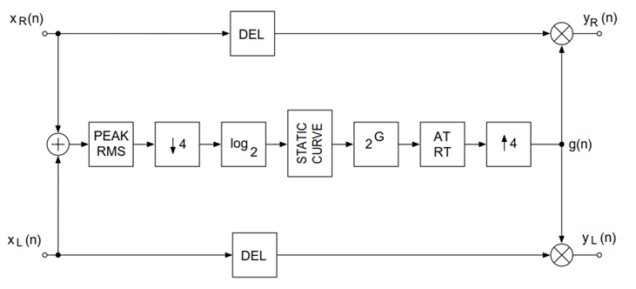
Stereo signals
For stereo signals, a common control factor g(n) is needed
That way the stereo balance is not displaced
Input signal level is measured from channel average
Dynamic range control of a stereo signal

Slide 36
Applications of dynamic range control
Music – make music sound louder without increasing its peak amplitude → music in public places.
Broadcasting – TV commercials heavily compressed to achieve near-maximum perceived loudness while staying within permissible limits (peak loudness by law).
Voice – De-essing: dynamic range control at sibilants (/s/ phoneme) frequency range (about 5 kHz).
Hearing aids – use a compressor to bring the audio volume into the listener's hearing range.
“Active sound protection" earmuffs/earplugs - let sounds at ordinary volumes be heard normally while attenuating louder sounds; possibly amplify softer sounds.

Slide 37
Thinking break (2 min)
Can you think of more DRC applications?

Slide 38
Equalizers

Slide 39
Equalizers
When reproducing audio in loudspeakers and headphones deviations from ideal audio reproduction can occur.
Equalization tries to compensate such deviation.
Sound is then manually adjusted until it is perceived with the desirable timbre (sound colour) or other quality.
It can also be applied automatically.
Equalization – adjusting the balance between frequency components within a signal

Slide 40
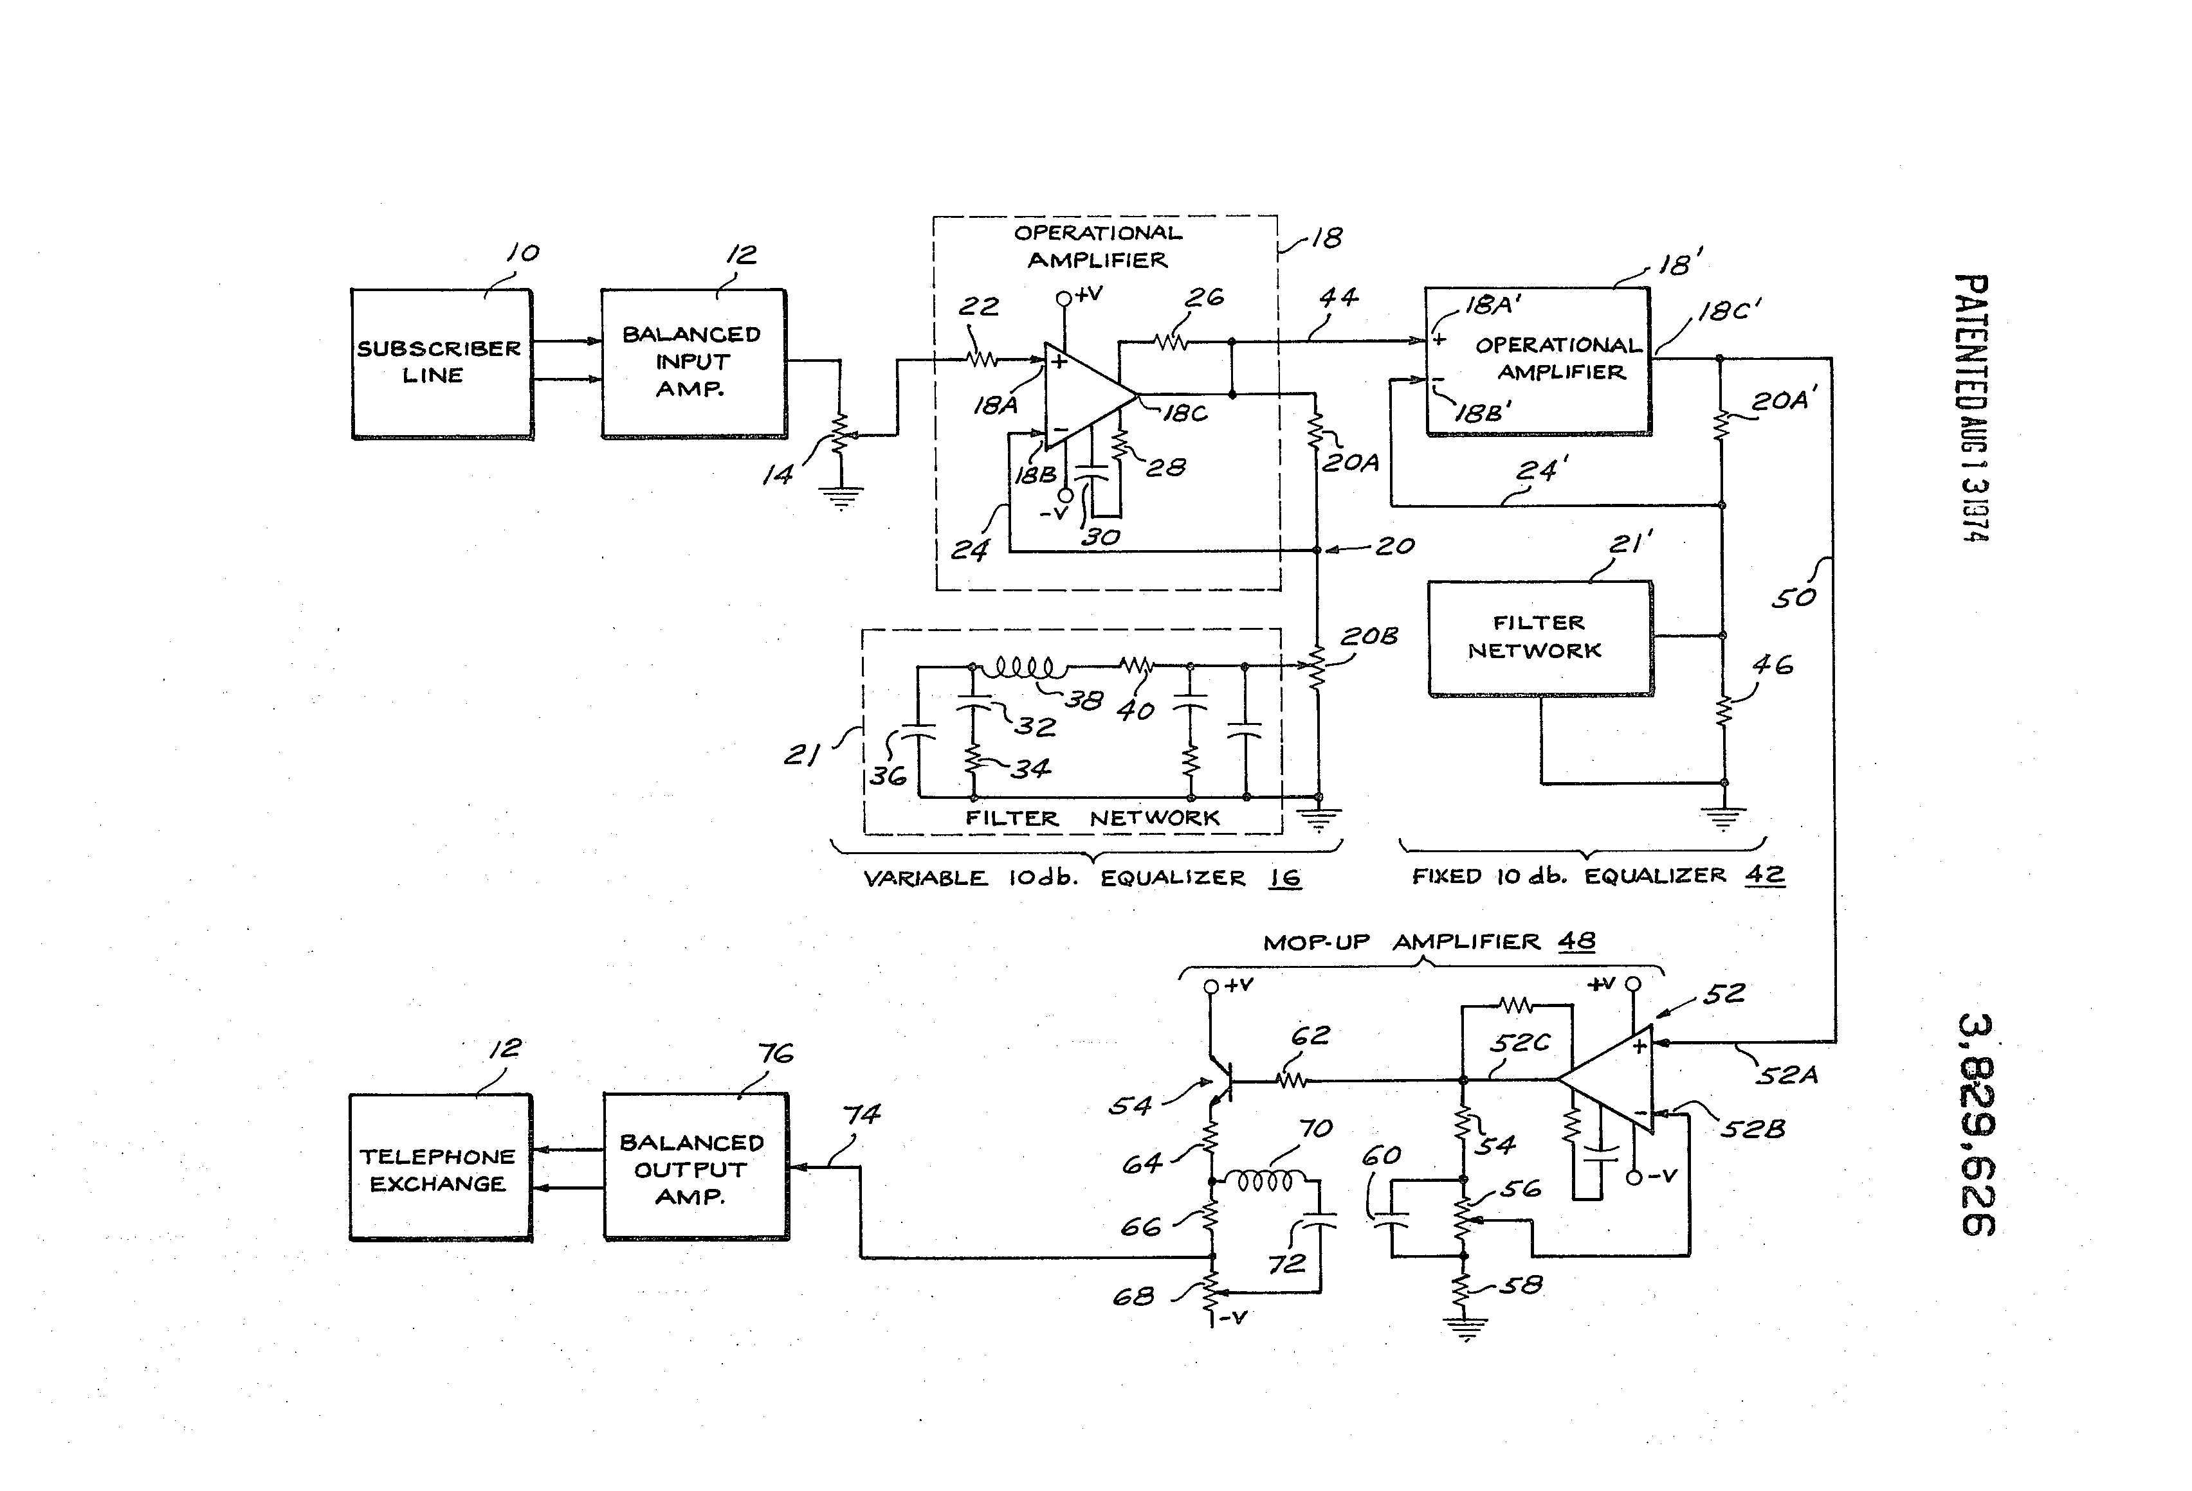
History
First were applied in correcting the frequency response of telephone lines to "compensate for" (i.e. correct) the uneven frequency response of an electric system
→performed by applying a filter having the opposite response
Later used in audio engineering to adjust the frequency response in recording, reproduction, and live sound reinforcement systems
→Resulting in a frequency balance of the music as heard through
Other uses: to modify frequency responses for aesthetic reasons.

Slide 41
Equalization
Equalizer – the circuit or equipment used to achieve it
Strengthen (boost) or weaken (cut) the energy of specific frequency bands; “frequency-specific volume knobs”
Found both in consumer products as well as in professional use
Consumer products (e.g. car radio or amplifier) often employ simple bass and treble control
Recording studios and professional audio often use more sophisticated equalizers capable of detailed adjustments
Correcting/adjusting frequency response

Slide 42
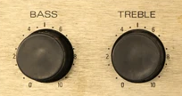
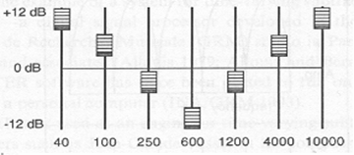
Equalizer
Turn specific frequencies up or down
Bass: low frequencies
Treble: high frequencies
All linear filters at the disposal of a listener or engineer

Slide 43
Audacity EQ tool
Original audio
Increase low frequencies lower high frequencies
Decrease low frequencies increase high frequencies
Manage → Factory presets → Bass boost

Slide 44
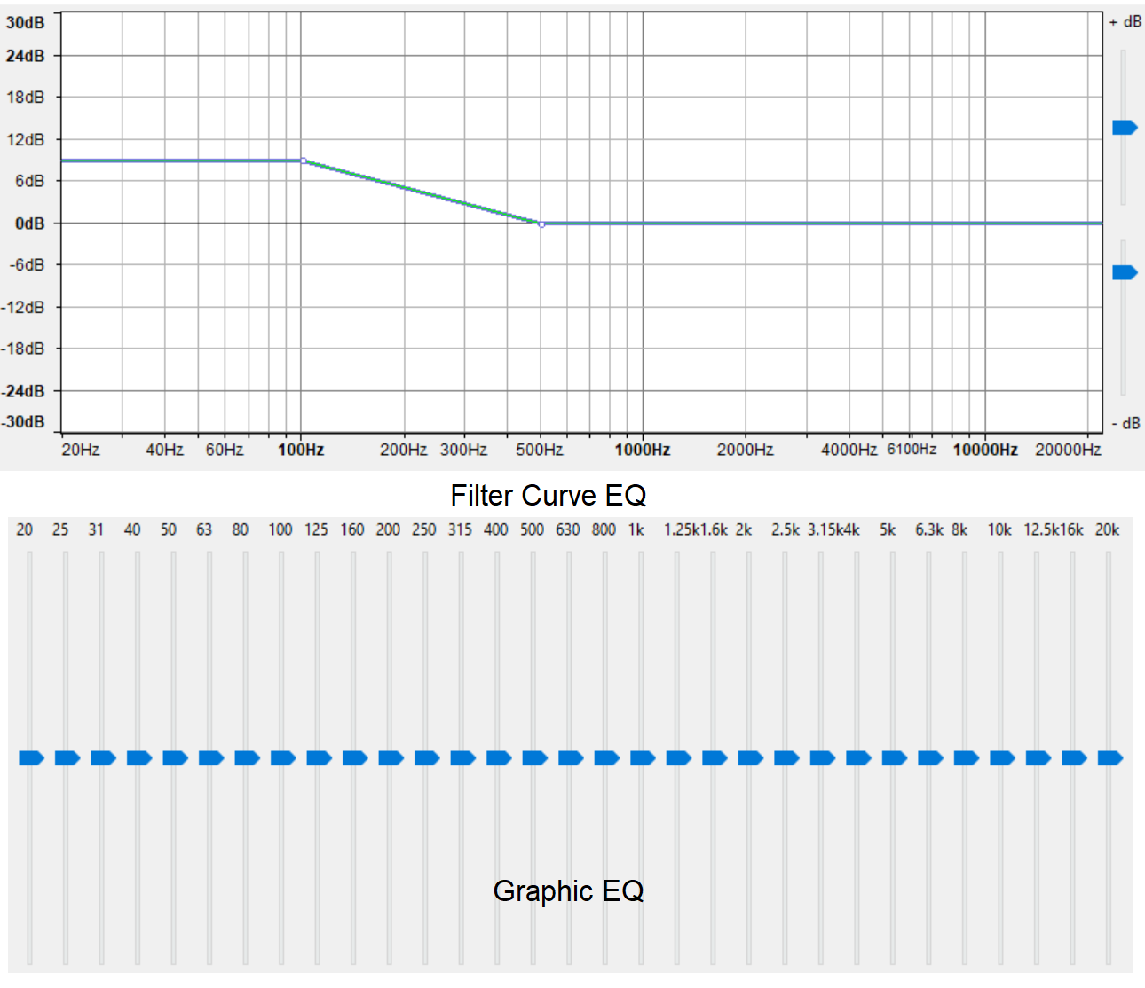
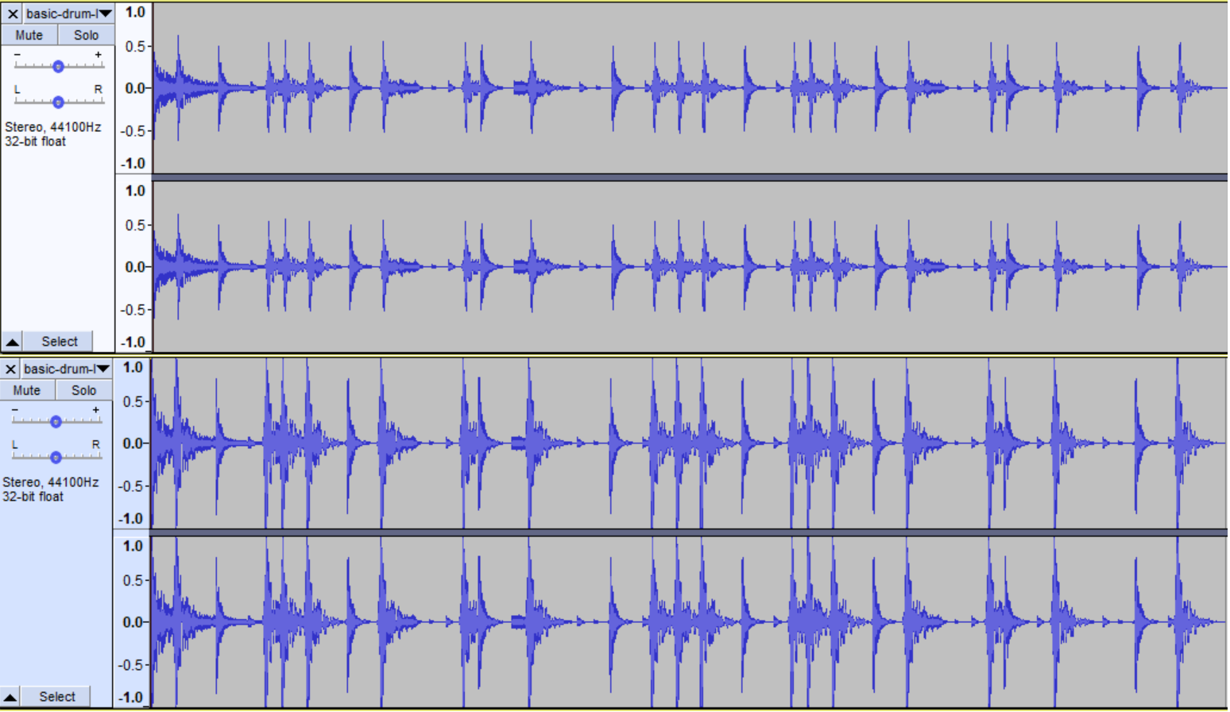
Audacity EQ tool
”Effect” → Filter Curve EQ / Graphic EQ

Slide 45
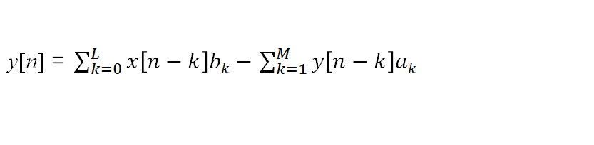
Digital linear filters
Remember digital linear filters:
𝑦[𝑛] = 𝑥[𝑛]𝑏₀+𝑥[𝑛−1]𝑏₁+…−𝑦[𝑛−1]𝑎₁−𝑦[𝑛−2]𝑎₂…
y[n] is the (current) output
x[n] is the current input at time n
b_{k}, a_{k} are coefficients that control the frequency response:
b_{k} controls input
a_{k} controls feedback

Slide 46
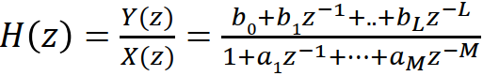
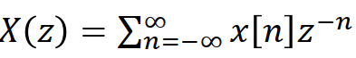
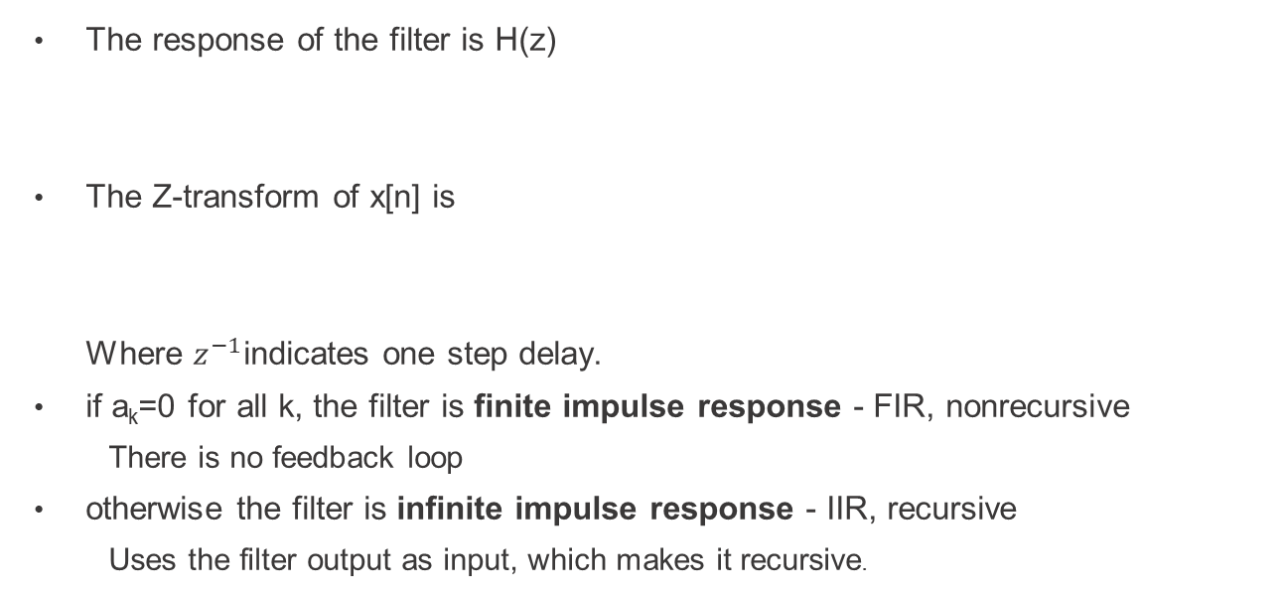
Digital linear filters
The response of the filter is H(z)
The Z-transform of x[n] is
Where $z^{−1}$indicates one step delay.
if a_{k}=0 for all k, the filter is finite impulse response - FIR, nonrecursive
There is no feedback loop
otherwise the filter is infinite impulse response - IIR, recursive
Uses the filter output as input, which makes it recursive.

Slide 47
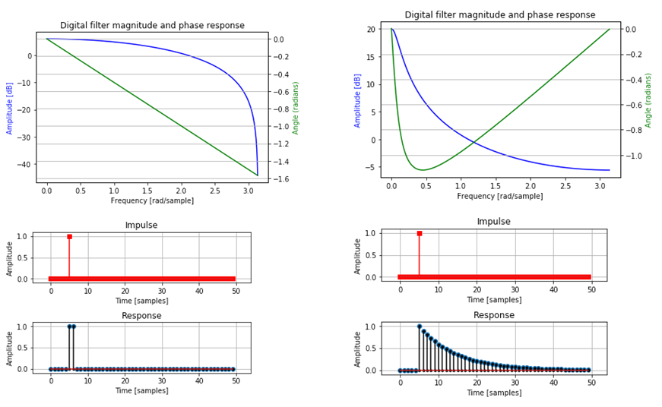
Digital linear filters
Example 1st order lowpass FIR (left) and IIR (right) filters

Slide 48
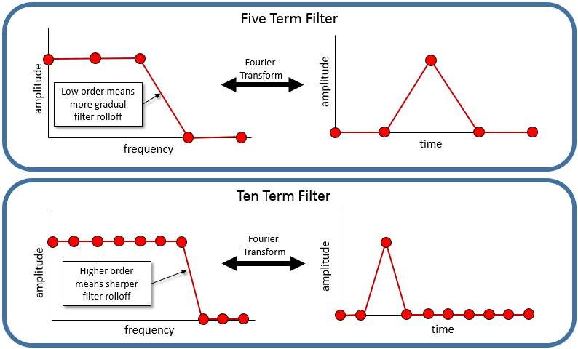
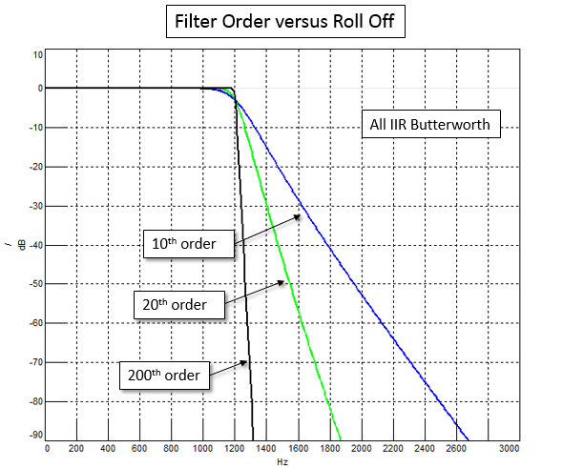
Filter order
More terms results in a sharper transition between the frequencies being stopped.
Images from https://community.plm.automation.siemens.com/t5/Testing-Knowledge-Base/Introduction-to-Filters-FIR-versus-IIR/ta-p/520959

Slide 49
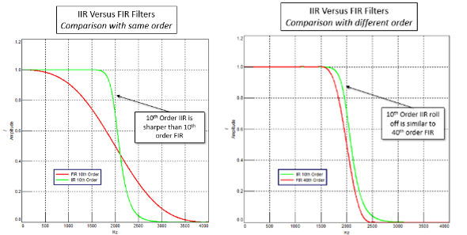
IIR or FIR for audio processing?
Computational efficiency:
IIR filters are faster from a computational point of view than FIR filters: a narrow transition band is achieved using a small number of filter coefficients (multiplication operations). Applications with IIR: interactive filtering while listening.
Higher the order → sharper the filter → more calcultations.

Slide 50
IIR or FIR for audio processing?
Delay: Filtered signal is a delayed version of the original at the passband.
FIR filter has equal time delay at all frequencies, while the IIR filter time delay varies with frequency.
Usually the biggest time delay in the IIR filter is at the cut off frequency of the filter.
In the case of audio that is not always important, since the human ear is not very sensitive to frequency component phases.
Magnitude response is perceptually more important
→ supports choosing IIR filters
However, phases at low frequencies affect the stereo image

Slide 51
IIR or FIR for audio processing?
Stability:
an IIR filter can sometimes be unstable; FIR filter formulation is always stable
FIR filters allow more accurate control of the filter response:
When designing filterbanks, FIR filters enable so-called perfect reconstruction, meaning that analysis/synthesis filterbank does not distort the signal if no processing is done at the subbands (Simplifies the design of an audio codec, for example)
IIR filters provide easier way of varying the filter response in real time (for example varying the cut-off frequency)
Parametric filter structures

Slide 52
IIR or FIR for audio processing?
→ Choice FIR / IIR depends on the application
IIR as shelving filters
FIR used in equalizers, acoustical modeling, reverberation effects, …
 | IIR | FIR
Computational speed | Fast / low order | Slow / high order
Phase / Delay | Not constant | Constant
Stability | Sometimes | Always

Slide 53
Shelving equalizers
High and low pass filters – useful for removing unwanted signal above or below a set frequency
Shelving filters – reduce or increase signals above or below a set frequency:
Tone controls (bass and treble) found in consumer audio equipment such as home stereos, and on guitar amplifiers.
Most usually these implement a first order response and provide an adjustable boost or cut to frequencies above or lower than a certain point.
Idea: Change the gain of some part of the spectrum while leaving other parts untouched
Obvious application to equalization: manipulating the system frequency response only at a given frequency range.

Slide 54
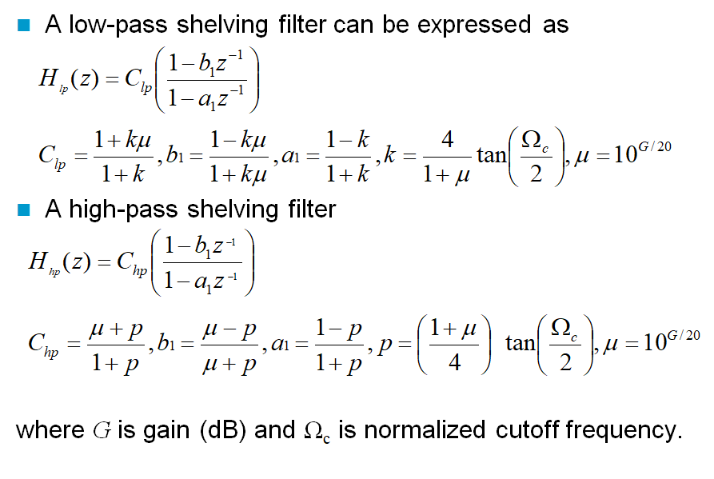
First order shelving filter design
For those who want more details,
not important for exam

Slide 55
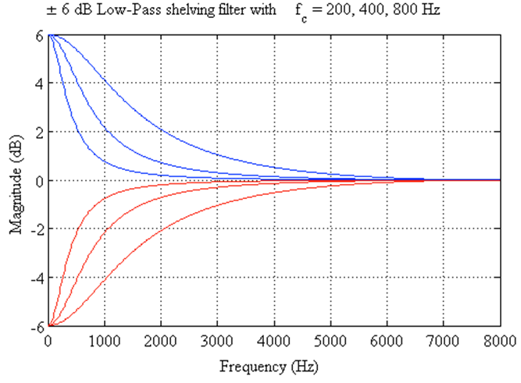
6 dB Low-Pass shelving filter responses

Slide 56



Example: low-pass shelving oboe
Oboe original
Low pass shelving

Slide 57

Peak filter
Another type of filter for boosting/cutting desired frequencies

Slide 58

Peak filter
For those who want more details,
not important for exam

Slide 59


Peak filter
A cascaded setup of peaking filters to design an audio graphic equalizer
Audio spectrum is divided into several frequency bands (Q and Ω set)
Each band’s gain (G) is controlled by the user
Analog equalizer

Slide 60
Parametric equalizer
Multi-band variable equalizers which allow users to control the three primary parameters: amplitude, center frequency and bandwidth
Capable of much more precise adjustments to sound than other equalizers; commonly used in sound recording and live sound reinforcement

Slide 61
Creative use of equalizers
Instead of fixing a problem, creativeness can be expressed with equalizers
Fullness: adding +4 to +6dB 100-300Hz range to emphasize weak instruments (e.g. acoustic guitar, harp)
Crispness: for percussion instruments by adding HF shelving boost above 1-2 kHz.
Emphasize articulation transients of instruments. E.g. boost frequencies of finger movements on string instruments.

Slide 62
Summary
Dynamic Range Control:
What is DRC and where it is needed
The basic idea of dynamic range compression
Level measurement and static curve define gain value
Different operation modes: Noise gate, Expander, Compressor, Limiter
Equalizers:
What is equalization and how it differs from filtering
What types of equalization operations exist
Parametric equalizers and their use

